Slide 1
SCI Recovery CS 6460: Ed. Tech
Final presentation
By dhruv Kapoor, Tolga Saygi, clark xu

Slide 2
Motivation
Spinal cord injuries (SCIs) impact 250,000 – 500,000 people around the world (World Health Organization, 2013)
Outcomes include paralysis, loss of sensation, increased chance of developing pressure ulcers, bladder dysfunction, neurogenic bowel, muscle atrophy, autonomic dysreflexia, and impaired sexual function (Sezer, Akkuş, & Uğurlu, 2015)
The best tools for prognosis have remained standard of care diagnostics such as MRIs and bedside evaluation, or traditional clinical analysis (Burns et al., 2012)
We wish to add to this clinical arsenal using both an educational platform as well as modern machine learning techniques
Notes:
So, what are scis and why are we interested

Slide 3
Prior Work
A mobile application for self-managing SCI was developed and received well by 20 injured individuals and 56 caregivers (Mortenson et al., 2019)
When surveyed, subjects with SCIs found that an internet-based platform that was designed for people with their own level of injury in mind would be best for developing informational resources (Munce et. al., 2014)
Age has been found to be a crucial factor when predicting recovery (Seel et al., 2001; Wilson et al., 2012; Wilson et al., 2014)
We found a lot of literature around SCI recovery using correlation or classical approaches such as linear regression, but none that used a comprehensive set of modern machine learning tools
Notes:
The prior work we paid special attention to include how information is preferred to be consumed and from where prognoses are derived from in practice

Slide 4
Purpose
To create a mobile application based on information surrounding spinal cord injuries (SCIs)
To provide educational content on the difficulty of predicting recovery following such injuries
To engage in novel research around predicting SCI recovery with respect to the ASIA impairment scale, which has widespread medical usage
To plug in predictive machine learning into the application so inference can be run for provided patient details
Notes:
5 stages, abcde, a is most severe with no motorsensory function
Will be demonstrated

Slide 5
Machine Learning Setup
NSCISC dataset was used, which had ~30,000 patient samples from USA
Extensive mapping was performed by referencing an included data dictionary to make sense of included data and its labels
EDA was performed for statistical probing into problematic data values
Intention was to create a multi-class supervised learning model
Target variable was ASIA score at discharge (5 classes)
Train:test split was 90:10 and the test set held injuries sustained after 2005
After one-hot encoding, 78 features were used to train models
Features included patient demographics and injury admission details

Slide 6
Machine Learning Results
Metric | Data | Value
Accuracy | Train | 0.82
 | Test | 0.72
Precision | Train | 0.77
 | Test | 0.46
Recall | Train | 0.56
 | Test | 0.45
F1-Score | Train | 0.55
 | Test | 0.43
9 different models were tuned against 8 metrics (4 for training and 4 for validation
ElasticNet was the best model

Slide 7
Feature Importance
We added an additional layer during model training to compute Shapely values
These give a measurement of how important each feature for making predictions
These are computed per output class and can be summed to give a quantitative view over the whole model
Taking the mean over the magnitude of a feature’s Shapely values combines the effects of predicting for or against a specific class

Slide 8
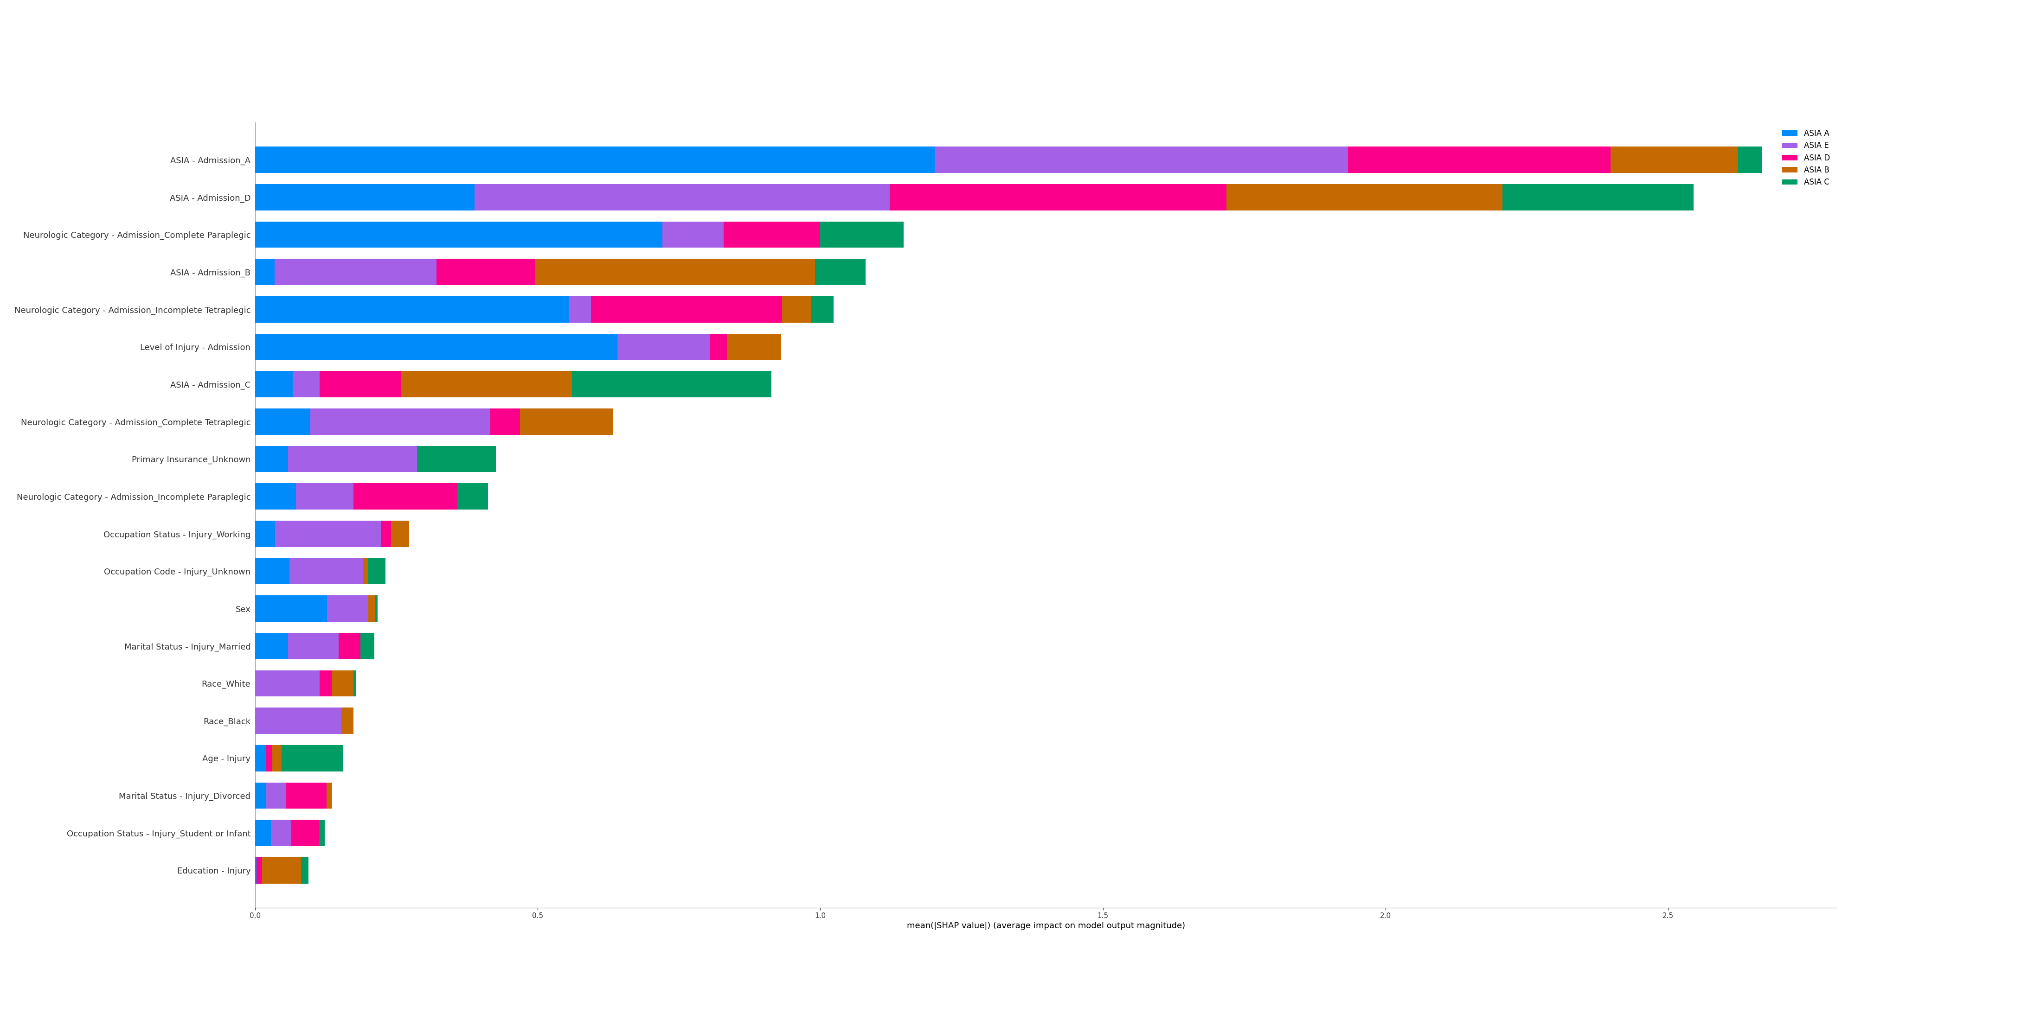

Slide 9
Inference Server
The machine learning model and server-side code to access it to make ad hoc predictions was hosted on a remote Ubuntu server
To support cross-platform development, Anaconda environment files were created for Ubuntu and Windows
Server API code was layered on top of the Falcon library to take in REST calls
The inference code itself was written to pull any model we have trained with ease since the training features are consistent across them all
A POST call to /PostInference on port 8000 could be used to run inference
Notes:
demo server and show diff output when a critical factor is changed

Slide 10
Mobile Application
The iOS application first introduces the user to SCIs by providing information on some basic statistics on these injuries
Prevention, treatment, and recovery are discussed on individual pages to gradually educate the user towards recovery predictability
Importance of certain characteristics about individuals is discussed (feature importance) in predicting ASIA classification at hospital discharge
A page to make such a prediction for a hypothetical patient is then presented
Upon entering information and making a request, the data is sent to the inference server and the resulting prediction is displayed to the user

Slide 11

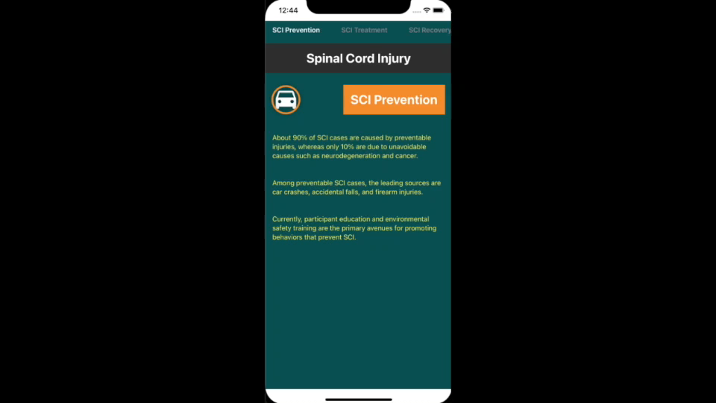
Mobile Application in Action

Slide 12
References
Burns, A., et al.(2012). Clinical diagnosis and prognosis following spinal cord injury. Handbook of Clinical Neurology 109. https://doi.org/10.1016/B978-0-444-52137-8.00003-6
Mortenson, W., Singh, G., MacGillivray, M., Sadeghi, M., Mills, P., Adams, J., & Sawatzky, B. (2019). Development of a Self-Management App for People with Spinal Cord Injury. Journal Of Medical Systems, 43(6). https://doi.org/10.1007/s10916-019-1273-x
Munce, S., Fehlings, M., Straus, S., Nugaeva, N., Jang, E., Webster, F., & Jaglal, S. (2014). Views of people with traumatic spinal cord injury about the components of self-management programs and program delivery: a Canadian pilot study. BMC Neurology, 14(1). https://doi.org/10.1186/s12883-014-0209-9
Seel, R., Huang, M., Cifu, D., Kolakowsky-Hayner, S., & McKinley, W. (2001). Age-Related Differences In Length Of Stays, Hospitalization Costs, And Outcomes For An Injury-Matched Sample Of Adults With Paraplegia. The Journal Of Spinal Cord Medicine, 24(4), 241-250. https://doi.org/10.1080/10790268.2001.11753581
Sezer, N., Akkuş, S., & Uğurlu, F.G. (2015). Chronic complications of spinal cord injury. World journal of orthopedics, 6(1), 24–33. http://dx.doi.org/10.5312/wjo.v6.i1.24
Wilson, J., Davis, A., Kulkarni, A., Kiss, A., Frankowski, R., Grossman, R., & Fehlings, M. (2014). Defining age-related differences in outcome after traumatic spinal cord injury: analysis of a combined, multicenter dataset. The Spine Journal, 14(7), 1192-1198. https://doi.org/10.1016/j.spinee.2013.08.005
Wilson, J., Grossman, R., Frankowski, R., Kiss, A., Davis, A., & Kulkarni, A. et al. (2012). A Clinical Prediction Model for Long-Term Functional Outcome after Traumatic Spinal Cord Injury Based on Acute Clinical and Imaging Factors. Journal Of Neurotrauma, 29(13), 2263-2271. https://doi.org/10.1089/neu.2012.2417
World Health Organization (2013). Spinal cord injury. https://www.who.int/news-room/fact-sheets/detail/spinal-cord-injury

